Slide 1
EIP Campaign
Millions of individuals haven’t yet accessed their $1,200 stimulus payment and have until October 15th to claim them this year
Notes:
Speak to various work done on EIP, moved with urgency and speed.

Slide 2
EIP Campaign: Target Population
Individuals and families with incomes under the $12,200 income threshold for required tax filing
Recipients of Medicaid, SNAP, TANF
People struggling with homelessness
People disconnected from the internet and financial institutions

Slide 3
EIP Campaign: Opportunity
Lack of awareness
Assumption that process if complex and cumbersome
Need assistance entering their information

Slide 4
EIP Campaign: Content
Guide and flyer: Core content includes a practical, step-by-step guide for frontline workers on how to increase awareness and provide assistance to clients
Webinars: Review of the guide and opportunity to answer questions for general public and more targeted to specific groups
Blog and emails: Supporting content where the guide and flyer are shared

Slide 5
EIP Campaign: Roll Out
Focused dissemination to intermediary organizations intersecting with the target population and serving large volumes of consumers ranging including the public, private, and non-profit sectors
Comprehensive distribution to hundreds of organizations and thousands of individuals via relationships with Consumer Education and External Affairs offices

Slide 6
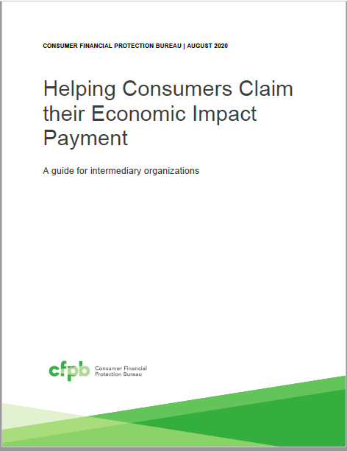
EIP Campaign: CFPB Guide

