Slide 1
The Impact of the COVID-19 Pandemic on Consumers and the Financial Market Place: Consumer Education
Desmond Brown
Sept. 23, 2020

Slide 2
Commitment to supporting consumers
The CFPB is committed to providing consumers with up-to-date information and resources to protect and manage their finances during this difficult time and as the situation evolves.
Notes:
PREVIOUSLY CLEARED SLIDE
---------------------------------
Commitment to supporting consumers
It’s important that consumers protect and manage their finances during the Coronavirus Pandemic. And the CFPB is committed to providing consumers with current information and resources to help them do that as the pandemic situation evolves.
Federal, state, and local governments, and communities are working to respond to the growing public health threat of coronavirus, or COVID-19. The temporary closure of businesses, schools and other public facilities or events are necessary steps to help reduce exposure. However, these actions may bring financial uncertainty for many people who could experience a loss of income due to illness or workplace closures.

Slide 3
How the CFPB is supporting consumers
Step 1: Collect input from consumers, stakeholders, and the market
Step 2: Analyze information to prioritize content development
Step 3: Develop new content or repurpose existing resources and tools
Result: Produce critical information and tools on relevant topics in real-time to help consumers when and how they need it.
Notes:
PREVIOUSLY CLEARED SLIDE
-------------
The CFPB is taking a number of steps to make sure we are providing consumers with the information and support they need to protect and manage their finances during this time.
As a first step, the CFPB is collecting and analyzing information from consumers, stakeholders, and the market to maintain a full-picture view and understanding of the quickly-evolving COVID-19 pandemic.
Consumer complaints: Since March 2020, we’ve seen an increase in complaints submitted to the CFPB. We’ve learned a lot from these complaints.
For example, consumers mentioning coronavirus-related terms submitted more complaints about mortgage and credit cards than usual, expressing concern about paying their mortgages and problems with purchases on their credit card statements. (Source: May 2020 Complaint Bulletin)
Insights like these from complaints have helped us prioritize development of educational resources.
Stakeholder input: Additionally, we have been engaging with stakeholders from consumer advocacy groups to financial institutions to understand their priorities and ways the CFPB can support consumers during this pandemic.
Market analysis: The CFPB has also been closely monitoring various markets to understand general business trends and companies response to Covid- 19 including household trends, mortgage markets, auto-lending, credit card market, student lending.
We are also engaged in using data collected from federal partners like the Federal Trade Commission and General Services Administration who receive complaints or inquiries related to scams or financial challenges due to the Covid-19 pandemic.
These data inputs provide the necessary information and justification for content ideas submitted by Bureau staff, which are then prioritized for development by a combination quantitative and qualitative prioritization model.
This model allows us to assess the urgency, scope, and content development needs of real-world issues in real-time, ensuring that consumers are provided with the most helpful and most critical information when and how they need it.

Slide 4
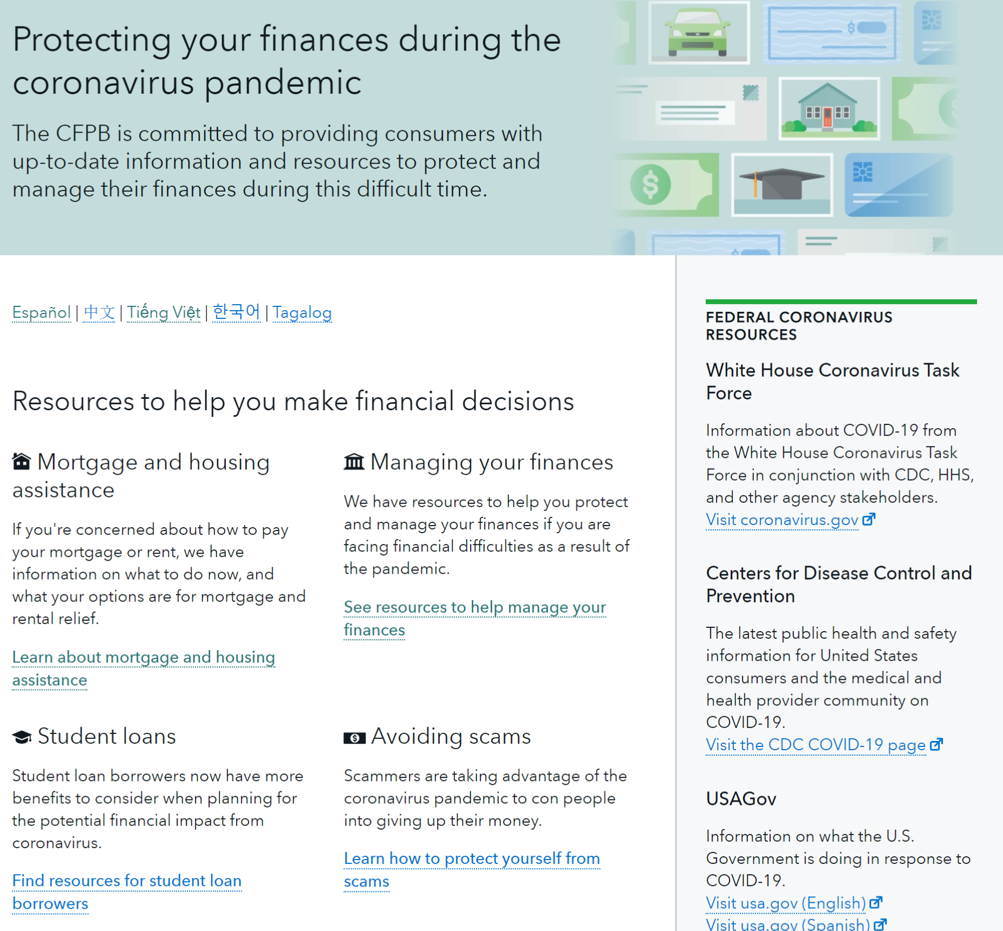
Notes:
CLEARED CONTENT FROM WEB
--------------------------
After Congress passed the CARES Act, the Bureau quickly developed a suite of educational resources explaining important components of the law and how consumers can take advantage of them.
In responding to the pandemic, we use a diverse toolbox to reach consumers: Website, Social media, Video, Email lists, Webinars and other Stakeholder engagement
On the web, we have centralized our resources to help consumers protect their finances during the coronavirus pandemic and get help with they need it at www.consumerfinance.gov/coronavirus
From March 13 – August 29, 2020 almost 3.6 million users have accessed our educational web content in response to COVID-19.
The Bureau has also published:
33 blogs on ConsumerFinance.gov;
Over 45 substantial updates to these pages and blogs;
122 blog translations and translation of the interagency housing microsite into Spanish, Traditional Chinese, Simplified Chinese, Tagalog, Vietnamese, and Korean;
20 videos with more than 339,751 views on YouTube, Facebook and Twitter;
140 emails;
And our social media messages have reached 54.3 million unique users.
Content topics and themes
Content on our coronavirus page covers various topics and resources that can help consumers during the financial uncertainty of the pandemic.
Some topics include:
Mortgage forbearance and other housing protections
Economic Impact Payments, unemployment and other forms of assistance
Credit and debt management
Student loan repayment
Avoiding scams

Slide 5
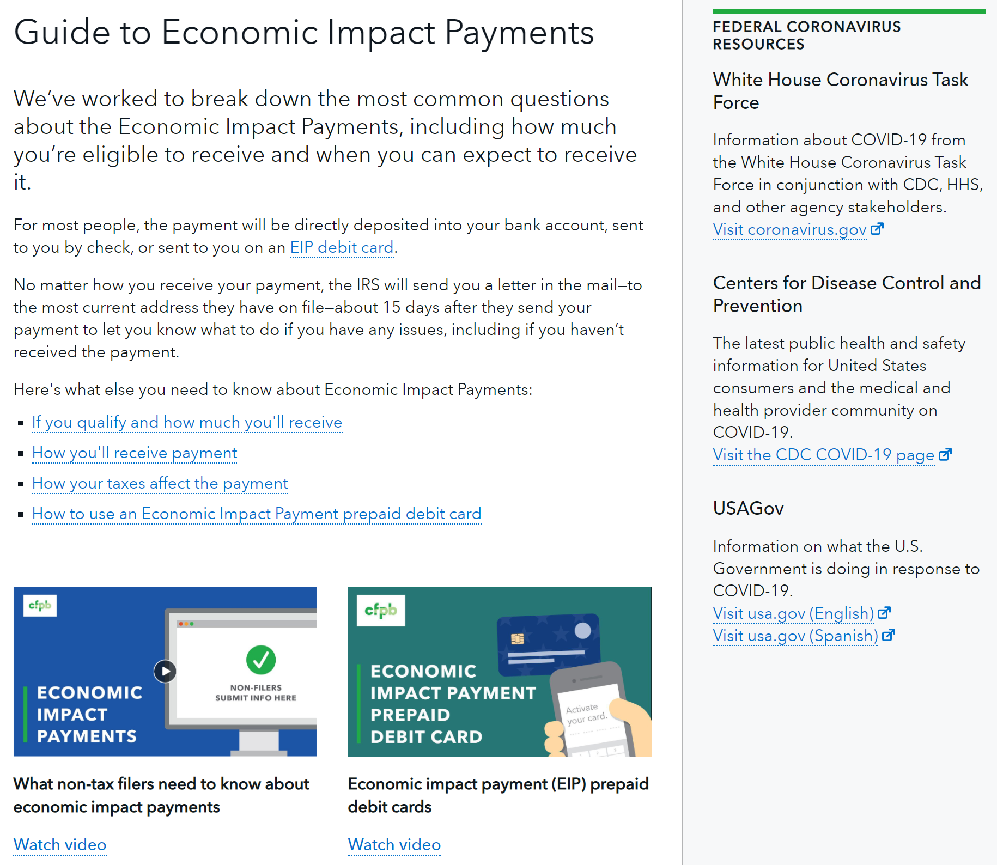
Notes:
CLEARED CONTENT FROM WEB
--------------------------
Following passage of the CARES Act we worked closely with the Department of Treasury to help consumers get answers about stimulus payments.
We produced blogs, web pages and videos to help people understand if they qualified, how to get payments, how their taxes affected their payment and how to use EIP prepaid cards.
We’ve also produced a comprehensive guide on the subject for coaches, advisors and other intermediaries.

Slide 6
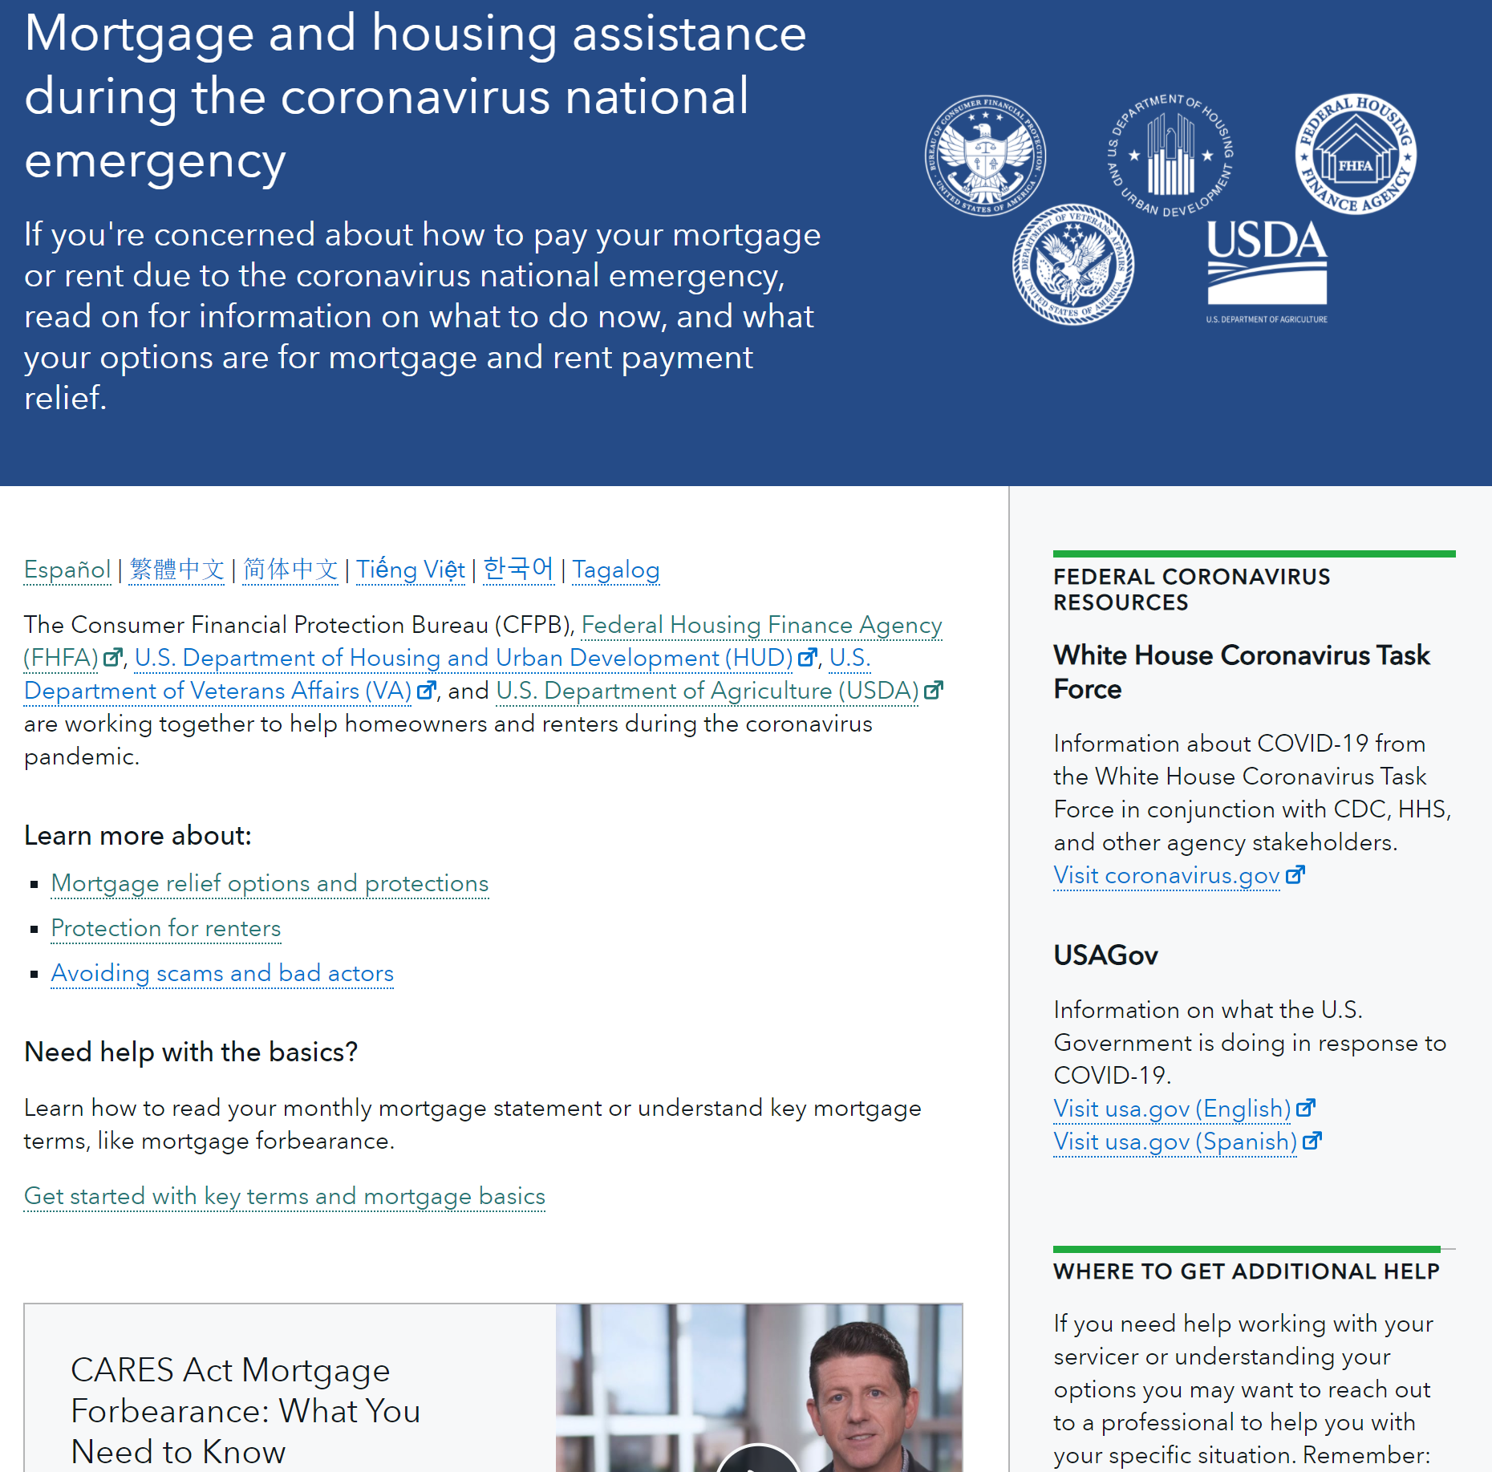
Notes:
CLEARED CONTENT FROM WEB
--------------------------
To ensure homeowners and renters have the most up to date and accurate housing assistance information during the COVID-19 national emergency, the Bureau partnered with the Federal Housing Finance Agency (FHFA), and the Department of Housing and Urban Development (HUD) to create a new mortgage and housing assistance website https://www.cfpb.gov/housing.
This joint website consolidates the CARES Act mortgage relief, protections for renters, resources for additional help, and information on how to avoid COVID-19 related scams. It also provides lookup tools for homeowners to determine if their mortgage is federally backed, and for renters to find out if their rental unit is financed by FHA, Fannie Mae, or Freddie Mac.
The CFPB actively coordinates with HUD, FHFA, VA, and the USDA to keep consumers apprised of their options when it comes to mortgage and housing assistance. As federal housing assistance programs are implemented, modified or expanded, this interagency housing hub is the place where consumers can go for updated information on what resources are available to them.
Since May 10, the site has served 469,147 users.

Slide 7
Consumer Education highlights
Office of Older Americans
Elder Fraud Prevention and Response Networks
Section for Students and Young Consumers
Paying for College Tools
Office of Servicemembers Affairs
Financially Fit Report
Office of Community Affairs
Office of Financial Education
Credit Builder Loans Report
K-12 Teacher Activities
Notes:
NEW SLIDE
Assistant Directors to provide updates.

