Slide 1
COVID-19 Response: Homeowners
November 2020

Slide 2
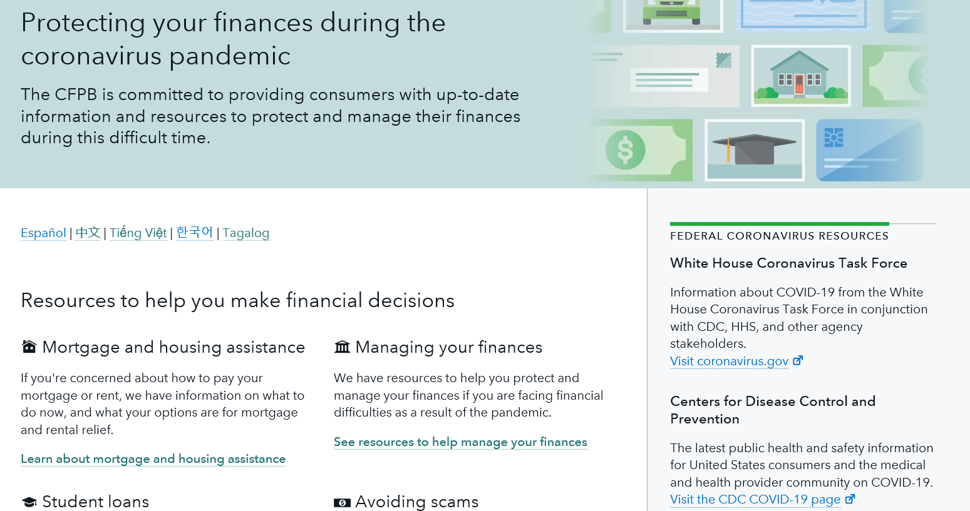
Bureau COVID-19 resources for homeowners
Centralized CFPB landing page: Protecting your finances during the coronavirus pandemic
CARES Act mortgage protections blog and resources
Joint agency housing hub: (HUD, FHFA, VA, and USDA)
Mortgage relief options and protections
Protections for renters
Avoiding scams

Slide 3
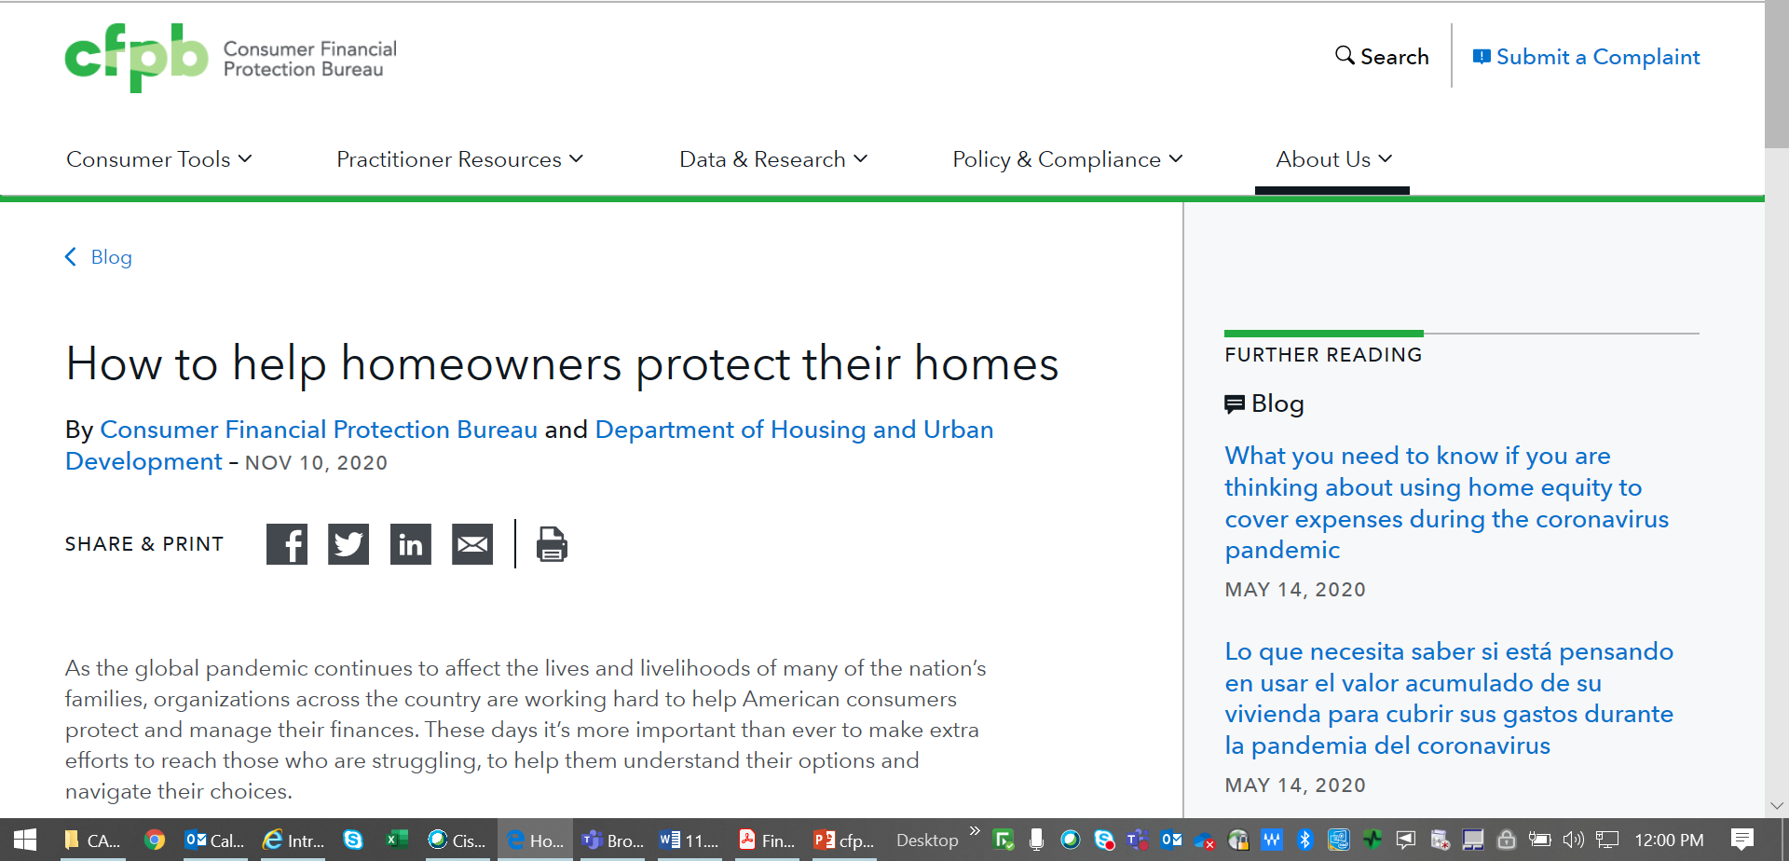
Forbearance outreach initiative

Slide 4
Simplified top of housing portal landing page

Slide 5
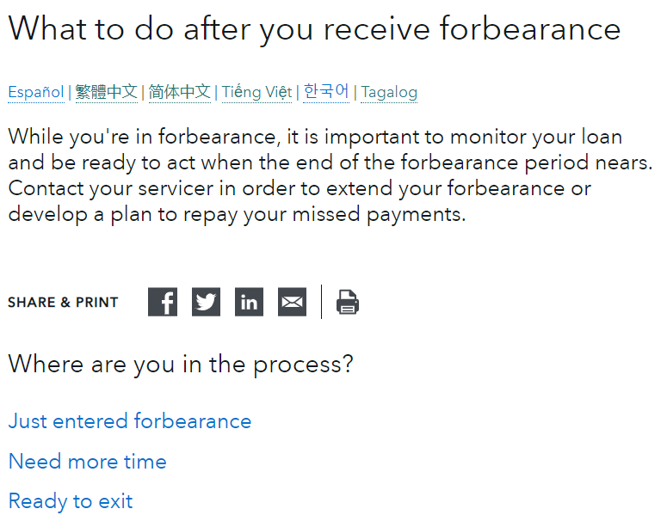
Updated housing portal pages

Slide 6
Introduced 3 new forbearance consumer guides
7 Facts about forbearance
Next steps if your forbearance is ending
How to start forbearance

Slide 7
Mortgage Servicing Collaborative

